Slide 1

DATA CONSULTING

Slide 2
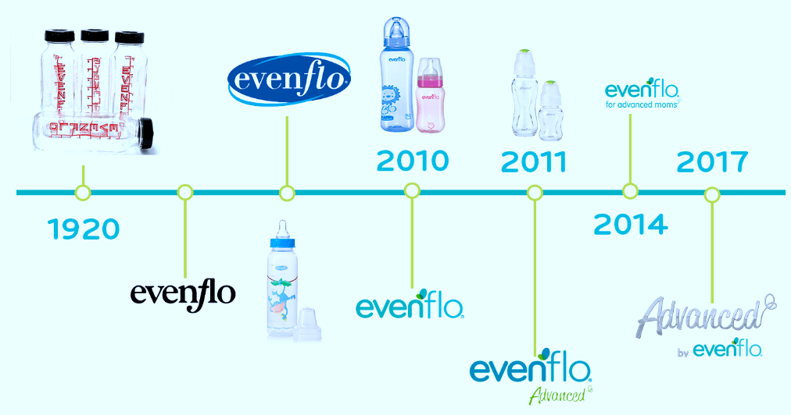
Our Company
At Evenflo® we are known for being a brand that has expanded and innovated in its products to always offer you the best for you and your baby...

Slide 3
Table of Contents
01
02
03
PROBLEM & SOLUTION
OUR PROCESS
TARGET
Analyze the distribution channels, through the sales channels provided by Kimberly Clark company. The main objective is to carry out an analysis of how to introduce the main products or star products (feeding bottles, training cups, nipples and bibs) through E-Commerce
Use the tools (Python, HTML, Tableau, Machine Learning, etc) that help us visualize the information provided by Kimberly Clark.
New moms

Slide 4
Understanding the Problem
Problem
Opportunity
The marketing area envisioned that its entire products were distributed only through self-service and specialized channels, which was not a bad thing, but it wants to exploit the digital part and minimize some costs.
KC wants his products to start being distributed through E-Commerce, so we want to analyze his four star products and explote this area of opportunity.

Slide 5
Data Base
The data was generated in a fictitious way, the information was investigated and organized, so that we could offer information on the true products offered by the brand, but emphasizing that the figures are totally invented by the work team.

Slide 6
Excel Analysis
Growth of the 4 INFANTI subsegments of the 1st Semester 2022 vs. 1st Semester 2021
38%
Maximize Profits
Product 2
Vasos
Growth of the 4
sub-segments
of INFANTI
Product 1
Baberos
71%
Product 3
Biberones
Product 4
Mamilas
100%
17%
8%
50%
0%

Slide 7
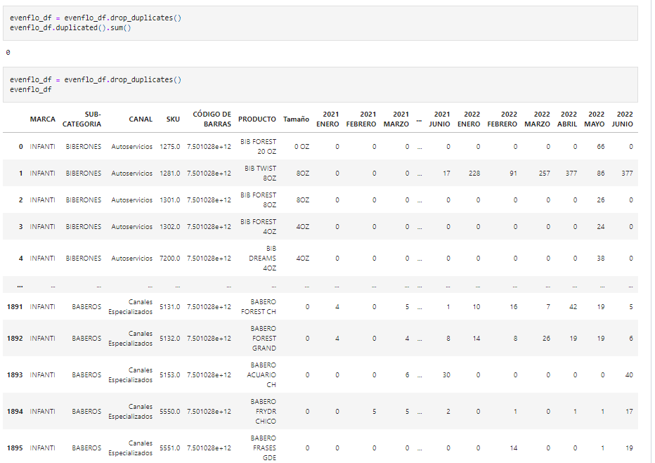
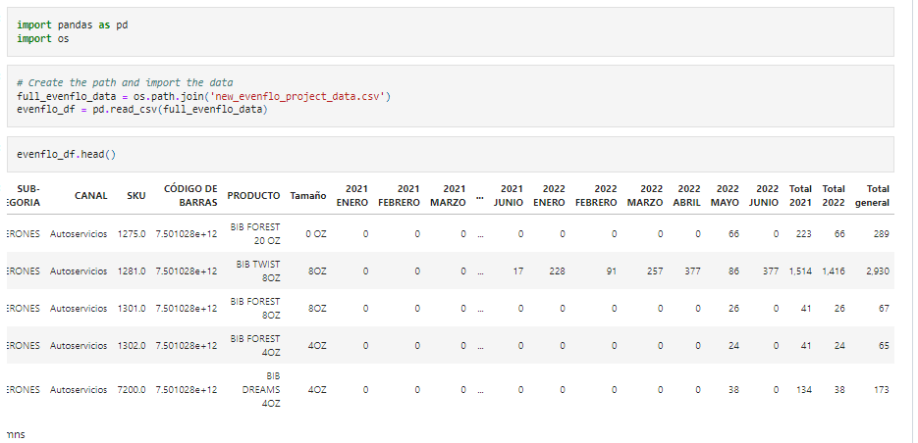
Python
Collect, prepare, and analyze data such as explanatory text using Pandas and Jupyter Notebook..

Slide 8
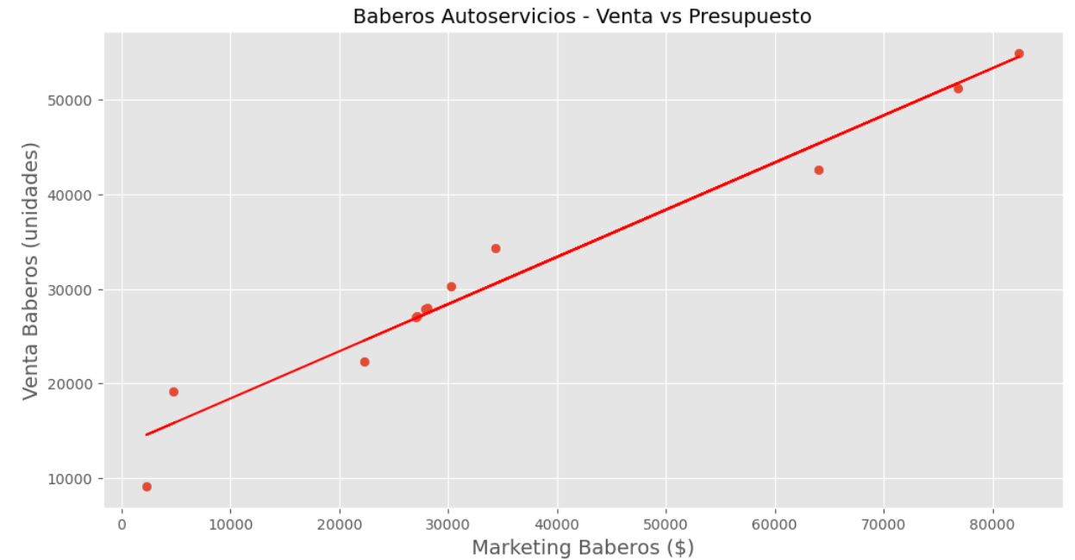
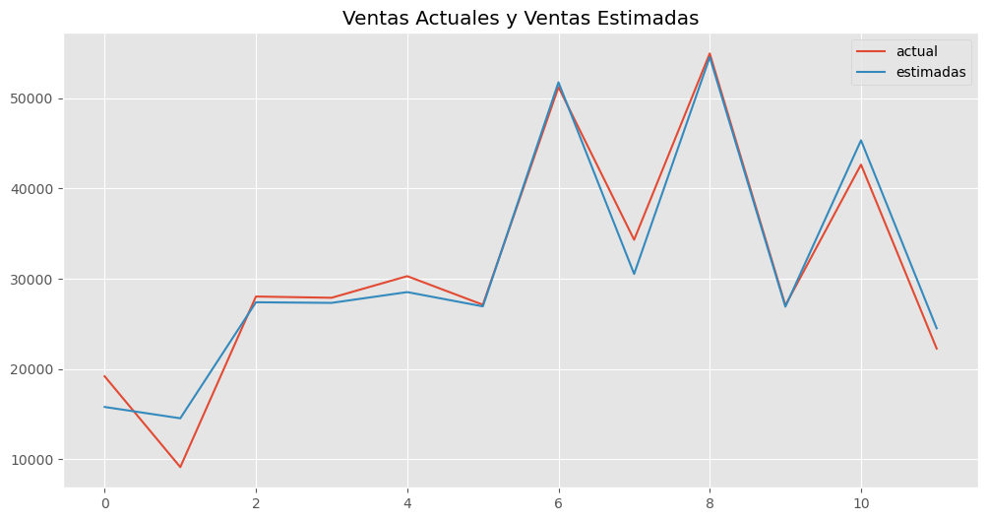
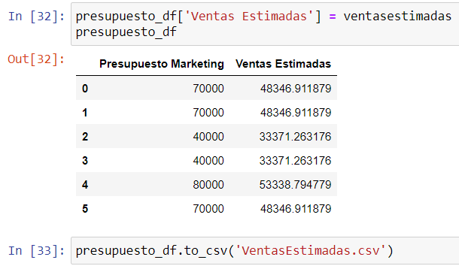
Machine Learning and Maplotlib
Simple Linear Regression Model
Predicted sales with changes in marketing budget
The output from the linear regression model
is a .csv file that will help in the business
planning process that the company follows

Slide 9
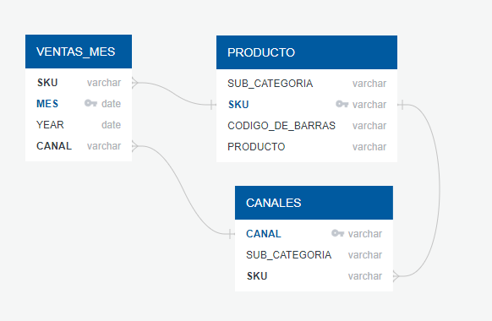
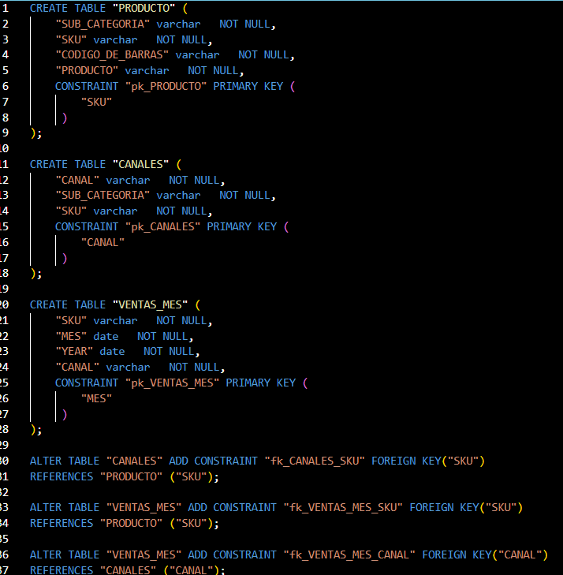
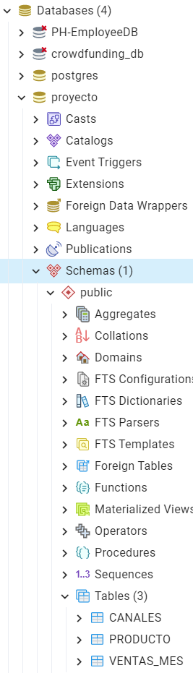
PostgreSQL / PG Admin / ERD
Database structure que Entity Relationship Diagram and using SQL to créate database tables

Slide 10
Analysis Tableau
TOP RATED VALUES
Distribution behaviors in the main cities in Mexico
121,813,713
121,811,023
20%
40%
30%
73,084,023
Guadalajara
Monterrey
Mexico City
Monterrey
Mexico City
Guadalajara
https://public.tableau.com/app/profile/rodrigo8277/viz/EVENFLO_products_finalproject/EVENFLO?publish=yes

Slide 11
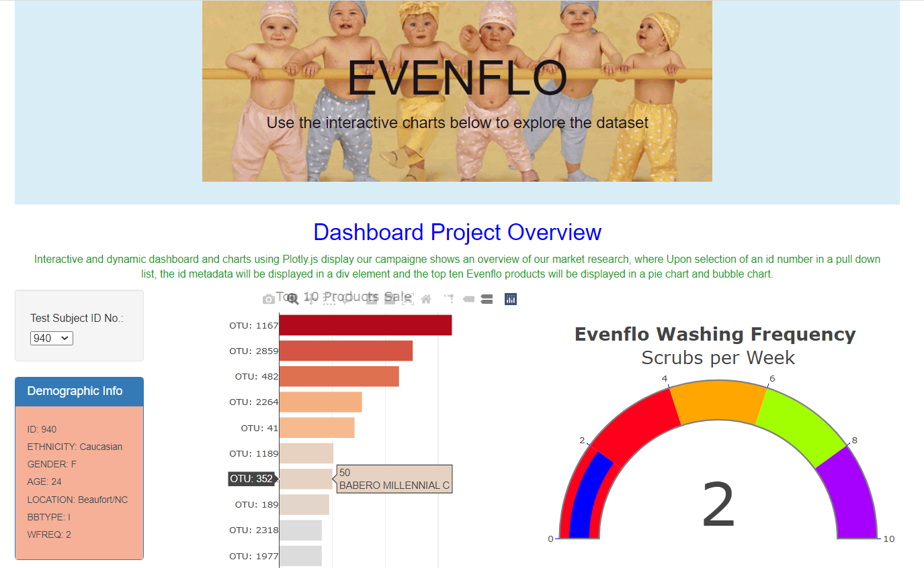
HTML
http://127.0.0.1:5500/index.html

Slide 12
THANKS

